Slide 1
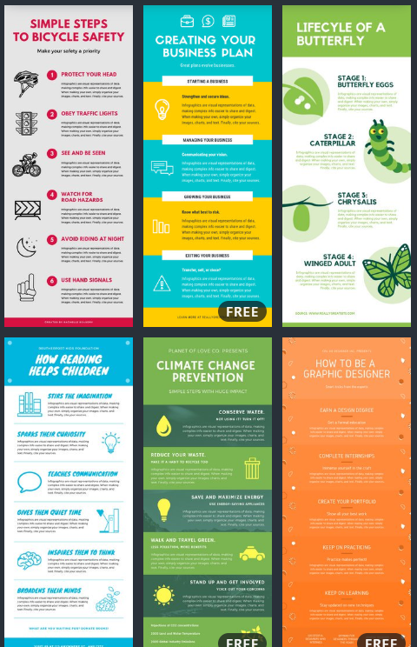
Create infographic
with
Apipong Pingyod - Maejo University Phrae Campus
NU1205 NURSING INFORMATICS AND COMMUNICATION IN NURSING

Slide 2
UNDERSTAND BEFORE CREATE
INFOGRAPHIC = INFORMATION + GRAPHIC
Good graphics or symbols make good Infographic
Make attention to audience in a few seconds
Do not dump a lot of details in Infographic
Please choose the details carefully
Can use QR-Code for more information if necessary

Slide 3
LAYOUT
DESIGN

Slide 4
TITLE
ABOUT RSV
SPREAD
SYMPTHOM
TREATMENT
Prevention
CONTACT & REF + QR-Code

Slide 5
Let’s CREATE

Slide 6
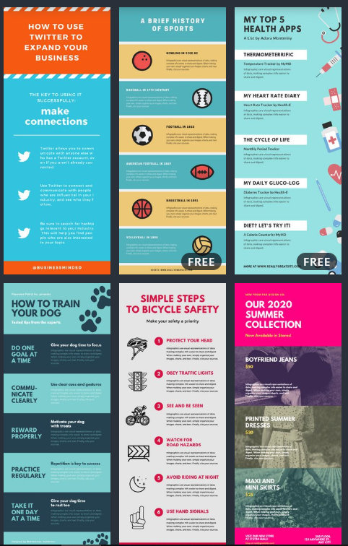
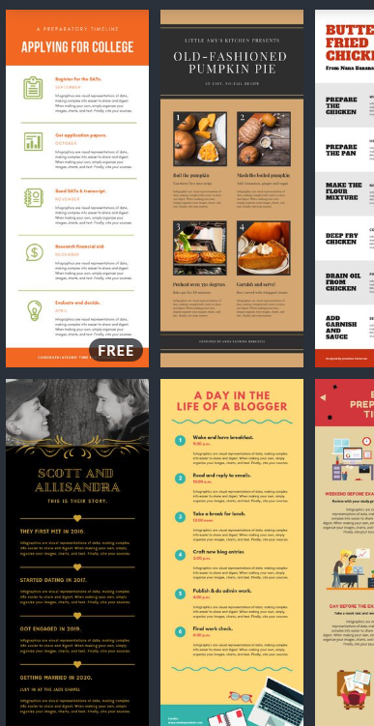
looking for “FREE” Infographic Template

Slide 7
UNLEASH YOUR IDEA with canva

Slide 8
EXAMPLE INFOGRAPHIC (FULL)

Slide 9
EXAMPLE INFOGRAPHIC (FIRST 3 Section)

Slide 10
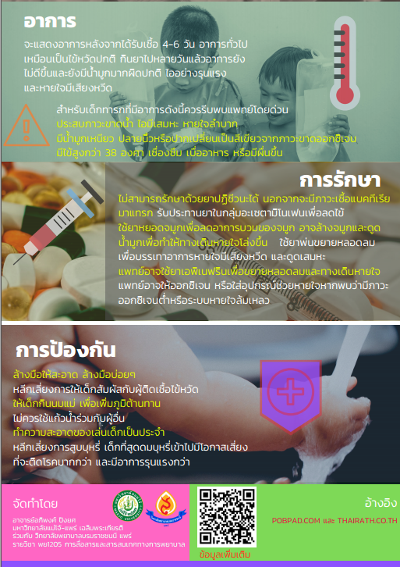
EXAMPLE INFOGRAPHIC (Last 4 Section)

