Slide 1
Create Brochure with
Apipong Pingyod - Maejo University Phrae Campus
NU1205 NURSING INFORMATICS AND COMMUNICATION IN NURSING

Slide 2
Canva is the most popular Online Design Tool
easily create media such as Social Media Posts, Documents, Blogging, Marketing Materials, Event, Ads, etc…

Slide 3
RESEARCH & DESIGN BEFORE CREATE

Slide 4
RSV is our case study in this course

Slide 5
ref : http://bit.ly/2NfniDJ

Slide 6
ref : http://bit.ly/2xgKIi1

Slide 7
LAYOUT
DESIGN

Slide 8
FRONT
Detail 4
Back Cover
Front Cover
IMAGE
IMAGE
IMAGE
DEFENSIVE
CONTACT
TITLE

Slide 9
BACK
Detail 1
Detail 2
Detail 3
ABOUT RSV
IMAGE
SPREAD
SYMPTHOM
TREATMENT

Slide 10
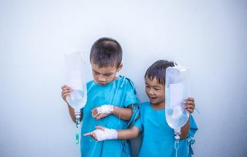
searching for PHOTOS

Slide 11
Let’s CREATE

Slide 12
Register in canva.com

Slide 13
Search “Brochure”

Slide 14
looking for “FREE” Medical Brochure or other

Slide 15
UNLEASH YOUR IDEA with canva

Slide 16
Search here
Download here
Edit here
Drop here
Drag here

Slide 17
EXAMPLE FRONT

Slide 18
EXAMPLE BACK

